Slide 1
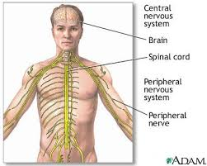
The Pathology of Nervous System Internship/Explorations 14-15

Slide 2
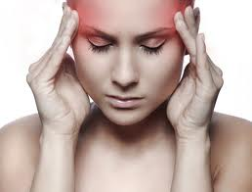
Cephalgia s/sx: Pain in the head above the eyes. AKA = ________________________ cephal/ =___________________ algia/ =_________________ Migraine: Often proceeded by a warning aura and characterized by throbbing pain on one side of the head. s/sx: warning aura, N/V, sensitivity to light or sound, more common in woman. Cluster headache: Intensely painful headaches that affect one side of the head associated with tearing of the eyes and nasal congestion. S/sx: pain, nasal congestion, more common in men

Slide 3
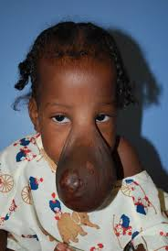
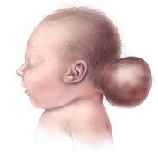
Encephalocele: Congenital herniation of brain substance through a gap in the skull. encephal/o = ____________ -cele = ________________ s/sx: neurological problems, ataxia (uncoordinated movements), seizures, vision problems, mental & growth retardation Tx: Surgery to put the part of the brain that is outside the skull back into place and close the opening.

Slide 4
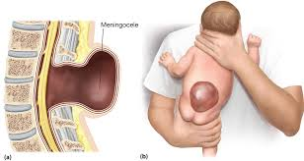
Meningocele: Protrusion of the meninges of the brain or spinal cord through a defect in the skull or spinal column forming a cyst filled sac filled with cerebrospinal fluid. Cause = ? (mystery) mening/o= ____________ -cele = _______________ s/sx: leg weakness, paralysis, scoliosis or club foot Tx: Surgical repair

Slide 5
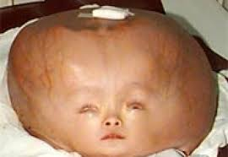
Hydrocephalus: Build up of fluid in the skull that leads to brain swelling. s/sx: eyes that gaze downward, irritability, seizures, separated sutures & sleepiness hydr/o = __________, cephal=____________ -us___________ Tx: surgical insertion of a shunt

Slide 6
Meningitis ______________=________________ ____________=___________________ s/sx: severe headache, NECK STIFFNESS & photophobia Encephalitis: ____________=______________ _____________=___________________ s/sx: fever, headache, confusion & possible seizures

Slide 7
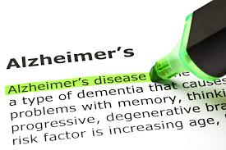
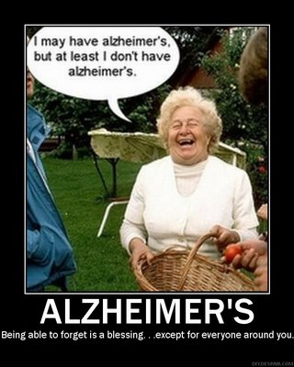
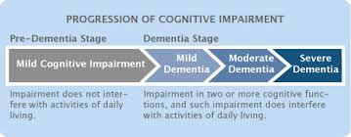
Dementia: Slowly progressive decline in mental abilities – memory, thinking & judgment. s/sx: personality changes , neglect self or have catastrophic reactions Alzheimer's Disease: Group of disorders involving parts of the brain that control thought, memory & language. s/sx: Memory loss, depression & irritability

Slide 8
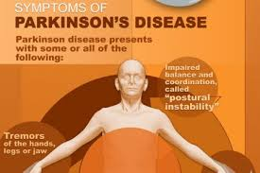
Parkinson’s Disease: Chronis degenerative CNS disorder. s/sx: muscle tremors, rigidity & slow shuffling gait

Slide 9
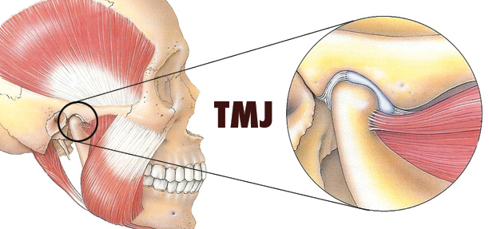
Reye’s syndrome: Potentially serious or deadly disorder in children, usually followed by a viral illness tx’d by aspirin. s/sx: vomiting & confusion Tetanus: aka _______________ Acute and potentially fatal infection of the CNS caused by toxin produced by tetanus bacteria. s/sx: spasms in jaw muscle or chest, neck or back with possible breathing problems

Slide 10
Amnesia: total or partial inability to recall past experiences. Delirium: Acute condition of confusion, disordered thinking or memory. s/sx: agitation or hallucinations

Slide 11
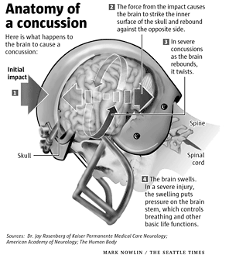
Concussion: Violent shaking up or jarring of the brain. s/sx: temporary loss of awareness, confusion, headache, vision problems, tinnitus or amnesia
Cerebral Contusion: Bruising of the brain tissue as a result of a head injury that caused the brain to bounce against the skull.
Cranial Hematoma –
word sx = cranium, blood, tumor
s/sx: vomiting & increased headaches

Slide 12
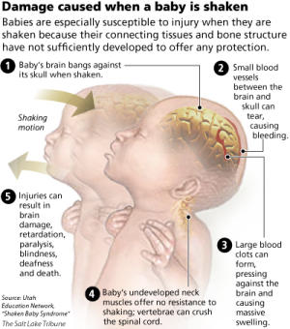
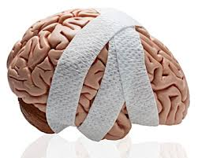
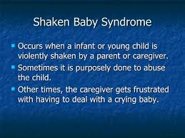
Traumatic Brain injury: A blow to the head or a penetrating head injury that damages the brain.
Shaken Baby Syndrome: Result of a child being violently shaken by someone.

Slide 13
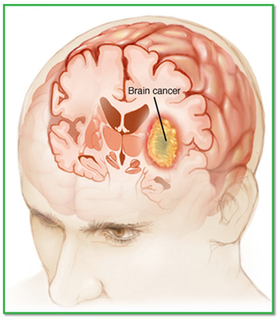
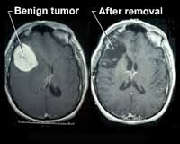
Malignant Brain Tumor: Destroys brain tissue – Cancer begins in the brain. Benign Brain Tumor: Does not invade the brain tissue because it is surrounded by rigid bone, as it enlarges, it can damage brain tissue by placing pressure against the tissue from increased intracranial pressure.

Slide 14
ICP = amt of pressure inside the skull.
Intracranial pressure
Symptom = causes sutures to separate

Slide 15
Cerebrovascular Accident a.k.a
stroke
abbreviation C V A
Damage to the brain due to blood flow disruption r/t a blood vessel being blocked or ruptured.
S/sx: right/left sided weakness
Ischemic Stroke: Flow of blood to the brain is blocked.
s/sx: changes movement, senses, and speech
T I A
Transient Ischemic Attack: TEMPORARY interruption in blood supply to the brain. Transient = quickly passing
s/sx: numbness, blurred vision, or dizziness
Hemorrhagic stroke: Blood vessel in the brain leaks or an aneurysm ruptures.

Slide 16
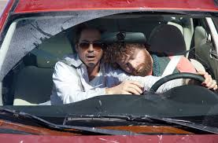
Sleep disorders -
Insomnia: Prolonged or abnormal inability to sleep.
Somnambulism: Walking or performing other activities while sleeping.
Narcolepsy: Sleep disorder consisting of sudden and uncontrollable brief episodes of falling asleep during the day.

Slide 17
More diseases of N.S.
Multiple Sclerosis – Progressive autoimmune disorder characterized by inflammation that causes demyelination of the myelin sheath.
Bell’s Palsy: Temporary paralysis of the seventh cranial nerve that causes paralysis only to the affected side of the face. ~numbness~
S/sx: inability to close eye of affected side, pain, tearing, drooling, impairment with taste, and ear sensitivity.
Amyotrophic Lateral Sclerosis (ALS) a.k.a Lou Gehrig's Disease – rapidly progressive disease attacks the nerve cells responsible for controlling voluntary muscles.
Guillain-Barre Syndrome – Inflammation of the myelin sheath of the peripheral nerves characterized by rapidly worsening muscle weakness. – can lead to temporary paralysis

Slide 18
continued
Trigeminal Neuralgia: Sever lightening like pain r/t inflammation of the 5th cranial nerve.
s/sx Sudden intense pain to cheeks, lips, gums & side of face
Cerebral Palsy: condition with muscle control spasticity, speech defects and other neurological deficiencies due to damage affects the cerebrum
S/sx uncontrolled body movements shaking/jerking

Slide 19
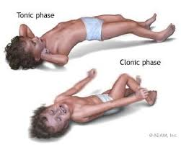
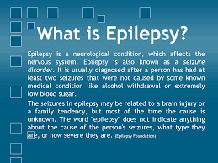
Epilepsy:
Chronic neurological condition characterized by episodes of recurrent seizures of varying severity.
- violent shaking or loss of consciousness

Slide 20
Peripheral Neuropathy
Disorder of the nerves that carry info to and from the brain and spinal cord.
Pain, loss of sensation. Inability to muscles (arms/legs)

