Slide 1
Nutrients

Slide 2
What are the Essential Nutrients?
Proteins
Carbohydrates
Fats
Vitamins
Minerals
Water

Slide 3
Protein
Amino Acids: organic compounds that combine to form PROTEINS
Proteins are the building blocks of life ☺
They help the body to BREAK DOWN FOOD
GROW
REPAIR BODY TISSUE
ENERGY
Essential amino acids cannot be made by the body. As a result, they must come from food.

Slide 4
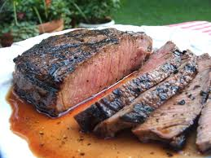
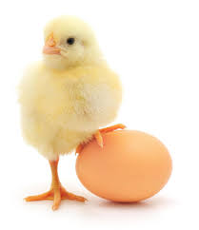
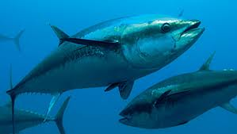
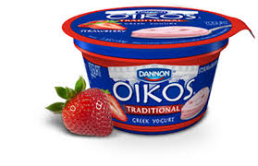
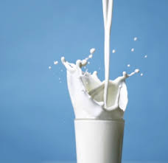
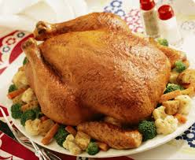
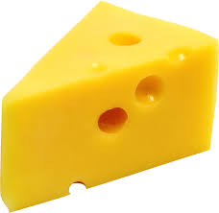
Complete Proteins: proteins that contain all 9 essential amino acids

Slide 5
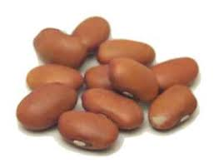
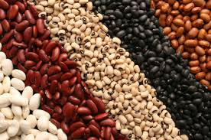
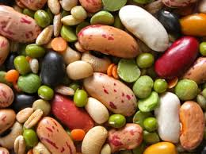
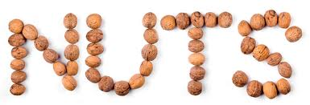
Incomplete Protein: proteins that do not contain all 9 essential amino acids

Slide 6
Carbohydrates
Carbohydrates are one of the main types of nutrients. They are the most important source of energy for your body. Your digestive system changes carbohydrates into glucose (blood sugar). Your body uses this sugar for energy for your cells, tissues and organs. It stores any extra sugar in your liver and muscles for when it is needed.

Slide 7
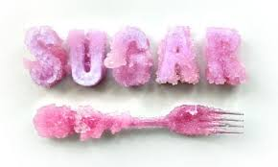
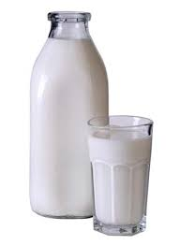
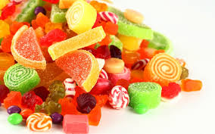
Simple Sugars (carbs)
Burn fastest!!!
Simple carbohydrates include sugars found naturally in foods such as fruits, vegetables, milk, and milk products. They also include sugars added during food processing and refining.

Slide 8
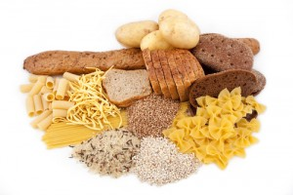
Complex Carbs
Complex carbohydrates include whole grain breads and cereals, starchy vegetables and legumes. Many of the complex carbohydrates are good sources of fiber.
Energy lasts over longer period than simple

Slide 9
Fats
Fats supply energy, and insulate, support, and cushion our organs.
They also provide medium absorption of fat-soluble vitamins.
HDL,LDL &Triglycerides ….what’s the difference?

Slide 10
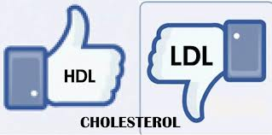

Slide 11
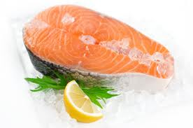
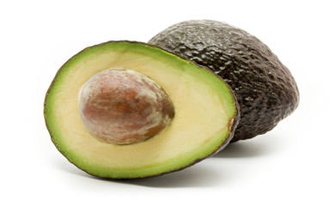
HDL – high density lipoproteins(cholesterol)
Good

Slide 12
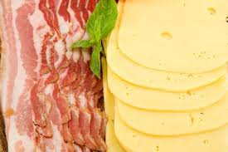
LDL – low density lipoprotein (cholesterol)
BAD

Slide 13
Triglycerides:
Triglycerides are a type of fat (lipid) found in your blood. When you eat, your body converts any calories it doesn't need to use right away into triglycerides. The triglycerides are stored in your fat cells. Later, hormones release triglycerides for energy between meals. If you regularly eat more calories than you burn, particularly "easy" calories like carbohydrates and fats, you may have high triglycerides (hypertriglyceridemia).Comes from

Slide 14
Causes of triglycerides:
Simple sugars
Saturated and trans fats
Refined grains or starchy foods
Alcohol
High calorie food that you do not utilize.

Slide 15
Vitamins
Fat Soluble
A, D, E, K
Water Soluble
C, B complex

Slide 16
Minerals
Minerals help regulate body functions, aid in the growth and
maintenance of body tissues, and act as catalysts for the release of energy.
Ex. Fluoride and Vitamin C together promote healthy teeth and gums.

Slide 17
There are two kinds of minerals: macrominerals and trace minerals.
Macrominerals are minerals your body needs in larger amounts. They include calcium, phosphorus, magnesium, sodium, potassium, chloride and sulfur.
Your body needs just small amounts of trace minerals. These include iron, manganese, copper, iodine, zinc, cobalt, fluoride and selenium.

Slide 18
WATER
8 X 8 RULE
Drink at least 8 glasses of 8oz of water daily

Slide 19
HTN intro
http://www.heart.org/HEARTORG/Conditions/HighBloodPressure/AboutHighBloodPressure/Can-You-Escape-the-Silent-Killer_UCM_303314_Article.jsp#

