Slide 1
Complementary and Alternative Medicine
9.13 Discuss complementary (alternative) health practices as they related to wellness and disease prevention.

Slide 2
Complementary and Alternative Therapies
Abbreviated CAM
Complementary – used in conjunction with conventional medical care.
Alternative – used in place of conventional western medicine.

Slide 3
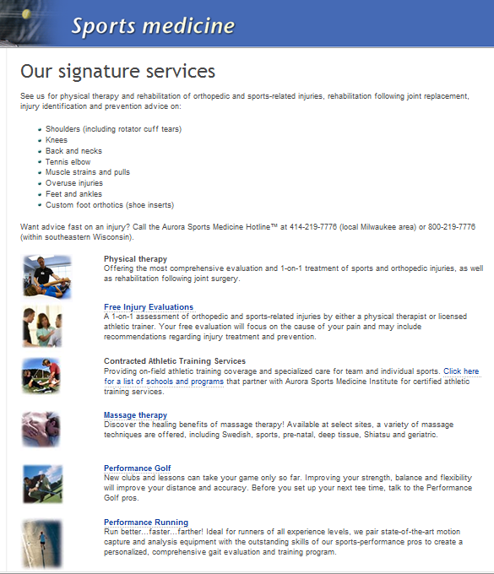
Today…
Conventional medical offices are integrating CAM therapies.
Conventional
Complementary

Slide 4
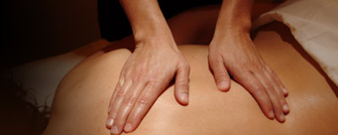
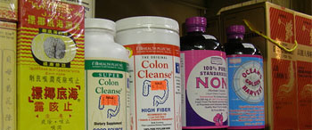
Safety
Some CAM therapies are safe and effective.
Some are not.

Slide 5
What Do You Think?
For each CAM therapy presented, do you think it is safe?
Do you think it works?
Why?

Slide 6
Alternative Medical Systems
Homeopathy
Using very small, diluted doses of drugs used to produce symptoms of the disease being treated, based on the belief that these substances stimulate the immune system to remove toxins and heal the body.
What do you think?

Slide 7
Alternative Medical Systems
Chinese Medicine (Acupuncture)
Insertion of very thin needles into specific points along the meridians in the body to stimulate and balance the flow of energy. Used to relieve pain, especially headache and back pain, reduce stress-related illnesses, and treat drug-dependency and obesity.
What do you think?

Slide 8
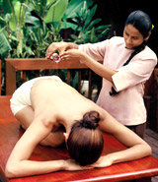
Alternative Medical Systems
Ayurveda
5000-year-old system practiced in India, treatments include herbs, massage, breathing exercises and yoga to integrate mind, body and spirit.
What do you think?

Slide 9
Natural Therapies
Aromatherapy
Therapeutic use of selected fragrances (concentrated oils from roots, plants and flowers) to alter mood and restore the body, mind and spirit. Used to relieve tense muscles, tension headaches, and lower blood pressure.
What do you think?

Slide 10

Natural Therapies
Herbal or Botanical Medicine
Used in almost all cultures since primitive times; belief that herbs and plant extracts contain compounds that alter blood chemistry, remove impurities, and strengthen the immune system.
What do you think?

Slide 11
Manipulative Methods
Chiropractics
Manipulation of the spine to correct misalignments that cause pressure on the nerves. Chiropractors may not prescribe drugs but may recommend nutritional and herbal remedies.
What do you think?

Slide 12
Manipulative Methods
Osteopathy
Physicians who receive training similar to MDs and take same state licensing exam as MDs.
Added focus on musculoskeletal system, good nutrition and favorable environmental conditions.
What do you think?

Slide 13
Manipulative Methods
Massage Therapy
Massage enables the muscles to relax, promoting better blood circulation, faster healing of injuries, and pain relief. Supplements other forms of therapy. Formal training programs are available.
What do you think?

Slide 14
Manipulative Methods
Reflexology
Ancient healing art, body divided into 10 equal zones that run from head to toe. Illness or disease causes calcium or acid deposits in the corresponding part of the foot. Pressure applied to specific parts of the foot to direct energy toward affected body part.
What do you think?

Slide 15
Holistic Medicine
Expansion of traditional medicine to include mental, emotional and spiritual well-being.
Consideration of the entire person when making therapeutic decisions.
Psychosomatic illness = physical symptoms resulting from what is happening in the mind.

Slide 16
Holistic Medicine
Emphasis of treatment
  Patients must accept responsibility for their own health.
  Stress is a factor and should be reduced.
  Proper nutrition and exercise essential.
  Attitude has a powerful effect.
What do you think?

